Slide 1

بسم الله الرحمن الرحيم
1
Concealing and Retrieving Messages behind an image
using a simple image processing technique.
Presented by:
Mohammad Zakaria
(ID: ET193025)
Submitted to:
Fazle Rabbi Adjunct Faculty Department of Electrical & Electronics Engineering International Islamic University Chittagong
International Islamic University Chittagong

Slide 2
Project Presentation Outline
2
Why did I choose this project? 3
01
Introduction 4
02
Methodology 5
03
Project Demonstration 6
04
Impact on humanity 9
05
Future Work 10
06
07
Conclusion 11

Slide 3
Why Did I choose this project?
3
01
In today's digital world, data security is a significant challenge due to increasing unauthorized access
02
Steganography provides a secure and innovative method to hide sensitive information in digital images, ensuring confidentiality during transmission.
03
This project combines image processing and encryption, which are essential skills in digital signal processing, making it both practical and impactful.

Slide 4

4
Introduction
Steganography
Steganography is the art of masking information with another kind of file such images or audio files.
Image Steganography
Text Steganography
Audio Steganography
This project focuses on
Image steg…
Science of hiding info withing an image
Embedded
Techniques
Message in LSB
Hidden data remains
Encryption
Decryption

Slide 5
Methodology
5
by
Encryption
Hiding and Retrieving Message
Decryption
Encryption
Hiding the Message
5. Save the new image with the hidden message in *BMP format* to avoid compression losses.
1. Import a base image and a message image.
2. Convert the message image into grayscale and then to binary format.
4. Embed the binary message into the least significant bit of the base image
3. Resize the message image to match the dimensions of the base image.
Load the image containing the hidden message.
Decryption
Retrieving the Message
Extract the binary data stored in the least significant bit using a decoding function.
Reconstruct and save the hidden message.

Slide 6
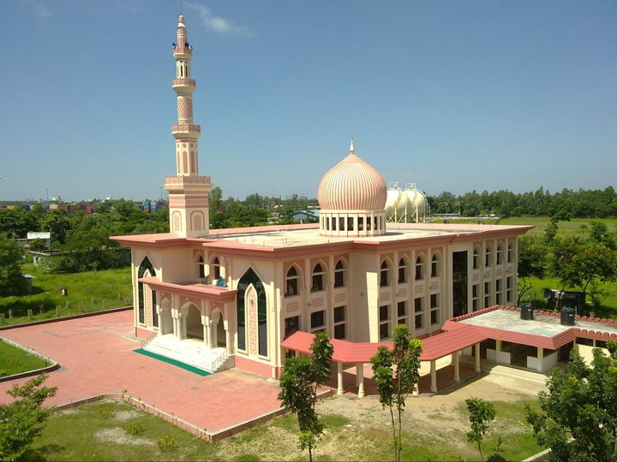
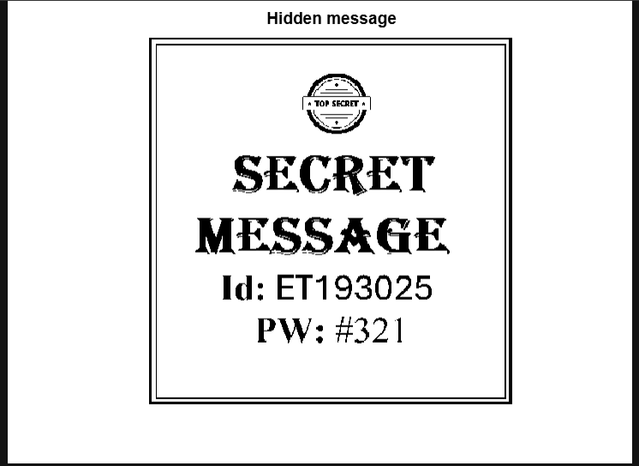
6
Project Demonstration
Hiding message
Base Image
%Import the Base Image
[fname, path]=uigetfile('*.*','Please select a Base file where you want to hide message:');
fname=strcat(path,fname);
[Base]=imread(fname);
figure
imshow(Base);
title('Base Image')
%Import the Message Image and convert to Binary Image
[fname, path]=uigetfile('*.*','Please select a file which you want to hide:');
fname=strcat(path,fname);
[Message]=imread(fname);
Msg = imbinarize(rgb2gray(Message));
figure;
imshow(Msg);
title('Hidden message’);

Slide 7
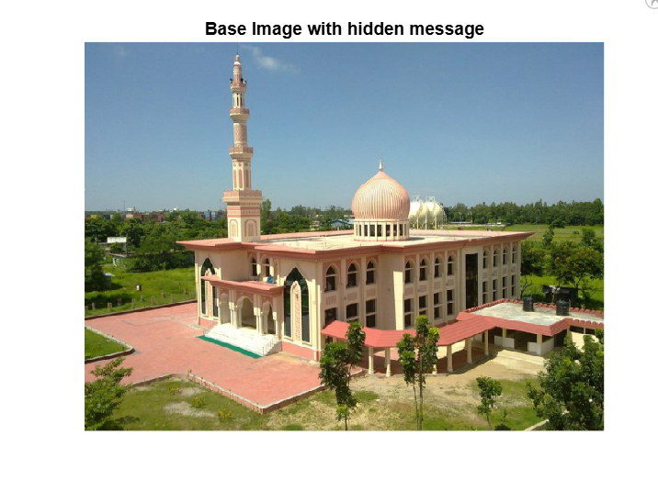
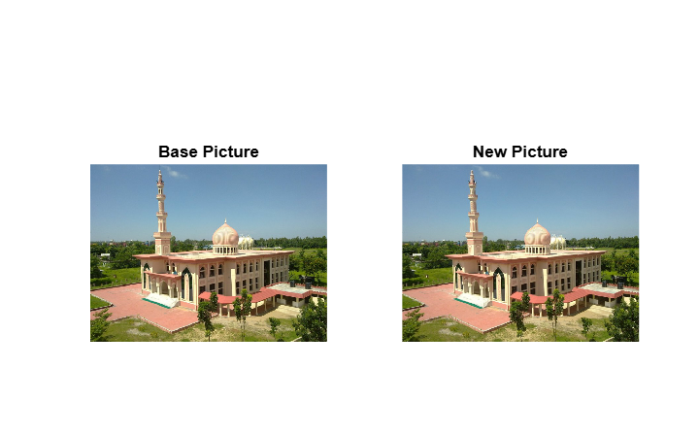
7
Project Demonstration
Hiding Message
%Resize the message and base image to same size
Msg = imresize(Msg,size(Base(:,:,1)));
Select a bit plane and change it to our message signal
New = Base;
New(:,:,1) = bitset(New(:,:,1),1,Msg);
Save the Image file
figure
imshow(New);
title('Base Image with hidden message')
figure;
subplot(121)
imshow(Base);
title('Base Picture')
subplot(122)
imshow(New)
title('New Picture');
imwrite(New,'3.1_MsgIm.bmp')

Slide 8
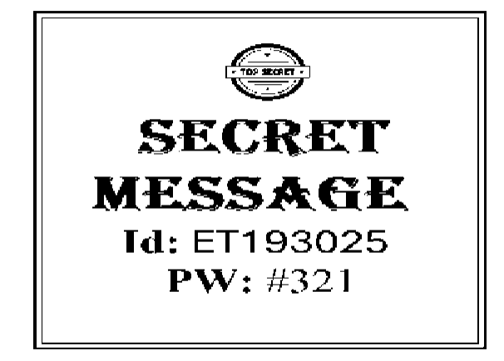
8
Project Demonstration
Unhiding Message
%Import the image with hidden image
[fname,path]=uigetfile('*.bmp*','Please select a file having message:');
fname=strcat(path,fname);
[Im]=imread(fname);
%Extract the bitplane of the Messsage Signal
MessageImage = bitget(Im(:,:,1),1);
%Save & Visualize the Message
imwrite(logical(MessageImage),'4.1_Decrypt_Message.JPG');
imshow(logical(MessageImage));

Slide 9
9
Impact on Humanity and Interdependence
Improved Security:
Enhances secure communication by protecting sensitive information from unauthorized access.
Applications in Sensitive Fields:
Useful in military, financial, and personal data protection.
Interdisciplinary Relevance:
Combines the fields of digital signal processing, cryptography, and image processing, showcasing how these domains work together to solve real-world problems.

Slide 10
10
Future Work
Electronic properties
1
Explore advanced steganography techniques for video and audio files.
2
Improve the robustness of the method against image compression and external attacks.
3
Develop algorithms to handle larger data payloads without affecting the image quality.
4
Implement AI-based steganography for enhanced security and efficiency.

Slide 11
Project Links
GitHub Link:
https://mohammad-zakaria/dspproject
MATLAB Online:
https://drive.mathworks.com/sharing/ET193025_DSP_Project

Slide 12
Conclusion
11
This project demonstrates the effectiveness of image steganography in securely transmitting messages.
By utilizing the least significant bits of a base image, the method ensures the hidden data remains invisible and intact.
The project highlights the importance of combining encryption and digital signal processing techniques to address modern-day security challenges.

Slide 13
Thank You!
Any
Question

